Slide 1
BCSE301L – PROJECT REVIEW 2 PULMONITOR AI AUTOMATED DETECTION OF PULMONARY CONDITIONS USING MEDICAL IMAGE ANALYSIS OF CHEST XRAY SCANS AND MACHINE LEARNING TECHNIQUES
SAMARTHA ( 21BRS1698 )
M AADHITH ( 21BAI1192 )

Slide 2
table of contents
01
02
03
04
05
06
INTRODUCTION &
Problem statement
LITERATURE REVIEW
PROPOSED SYSTEM
Existing academic works on Pneumonia detection from Chest X Ray Scans
ARCHITECTURE
MODULES
Description of modules used to build the software

Slide 3
INTRODUCTION
Pulmonitor AI is web application using a TensorFlow image classification model for automated detection and analysis of pulmonary conditions from Chest X Ray scan.
It ensures real-time and secure detection of pulmonary conditions. Ensures user privacy and compliance with healthcare standards.

Slide 4
PROBLEM STATEMENT
According to the World Health Organization (WHO), pneumonia is estimated to be responsible for around 2.6 million deaths annually, with a higher prevalence in developing countries.
In countries with insufficient medical infrastructure, there is a huge need for AI based automated detection of Pneumonia from Chest X Ray scans.
This software aims to solve this purpose, considering patient safety and data privacy

Slide 5
LITERATURE REVIEW
AUTHOR | PUBLISHED IN | TITLE | FINDINGS
Enes Ayan, Halil Murat Unver | 2019 Scientific Meeting on Electrical-Electronics & Biomedical Engineering and Computer Science (EBBT) | Diagnosis of Pneumonia from Chest X-Ray Images Using Deep Learning | After transfer learning and fine tuning, Vgg16 network exceed Xception network at the accuracy with 0.87%, 0.82% However, the Xception network achieved a more successful result in detecting pneumonia cases
Parveen, N. Ravia Shabnam Sathik, M. Mohamed | Journal of X-Ray Science and Technology, vol. 19, no. 4, pp. 423-428, 2011 | Detection of Pneumonia in chest X-ray images | Detection of pneumonia infection by unsupervised fuzzy c-means classification learning algorithm gives better result than the rest of the methods since each resultant pixel gives accurate value since it has a weight associated with it
Wasif Khan, Nazar Zaki, Luqman Ali | IEEE Access Volume 9, Pg 51747 - 51771 | Intelligent Pneumonia Identification From Chest X-Rays: A Systematic Literature Review | Deep learning-based algorithms achieve the best results for pneumonia classification with an accuracy of 98.7%, a sensitivity of 0.99, and a specificity of 0.98

Slide 6
Abdullahi Umar Ibrahim, Mehmet Ozsoz, Sertan Serte, Fadi Al-Turjman & Polycarp Shizawaliyi Yakoi | Springer Nature Jan 2021 | Pneumonia Classification Using Deep Learning from Chest X-ray Images During COVID-19 | Deep learning approach based on pretrained AlexNet model for the classification of COVID-19, non-COVID-19 viral pneumonia, bacterial pneumonia, and normal CXR scans gives 93.42% accuracy for four-way classification and 99.62% for two-way classification
Vikash Chouhan, Sanjay Kumar Singh, Aditya Khamparia, Deepak Gupta,Prayag Tiwari, Catarina Moreira, Robertas Damaševičius, Victor Hugo C. de Albuquerque, | MDPI Section Signal Processing and Machine Learning for Biomedical Data Jan 2020 | A Novel Transfer Learning Based Approach for Pneumonia Detection in Chest X-ray Images | After analyzing the obtaining of the predictions of all models, results of 5 models: AlexNet, DenseNet121, InceptionV3, GoogLeNet, and ResNet18, were combined and class which was most frequently predicted by all models was considered. This combination gave the remarkably best performance and achieved a test accuracy of 96.39%, with an area under the ROC curve of 99.34%, and the sensitivity as 99.62%.
Tawsifur Rahman, Muhammad E. H. Chowdhury, Amith Khandakar, Khandaker R. Islam, Khandaker F. Islam, Zaid B. Mahbub | MDPI Section Computing and Artificial Intelligence Apr 2020 | Transfer Learning with Deep Convolutional Neural Network (CNN) for Pneumonia Detection Using Chest X-ray | DenseNet201 outperforms the other deep CNN networks, with reduced bias and higher generalization.
Prateek Chhikara, Prabhjot Singh, Prakhar Gupta, Tarunpreet Bhatia | Springer Advances in Intelligent Systems and Computing volume 1064 | Deep Convolutional Neural Network with Transfer Learning for Detecting Pneumonia on Chest X-Rays | Deep convolutional neural network model with transfer learning, with preprocessing using filtering, gamma correction, equalization, and compression methods. The proposed model performs on par with ResNet, ImageNet, Xception, and Inception in terms of precision, recall, accuracy, and ROC accuracy score on the Women and Children’s Medical Center Xray dataset

Slide 7
PROPOSED SYSTEM
Pulmonitor AI is a simple and easy-to-use website that uses a TensorFlow image classification model (CNN + LSTM / SVM) to quickly identify pneumonia conditions from Chest X-ray scans
The results are displayed along with a confidence score and recommendation is issued to consult a medical practitioner.
This platform will be hosted on free tier version of Vercel. Pulmonitor AI ensures user data privacy and security.
It's made to be easy for regular people and doctors to use. This new system has the potential to make medical tests better, giving quick results and making it easier for doctors and patients.
PULMONITOR AI

Slide 8
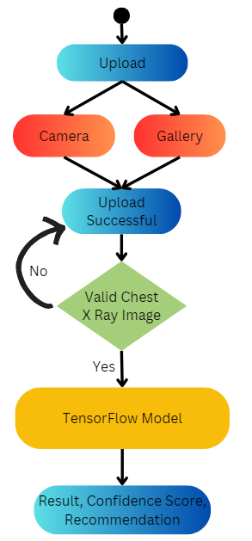
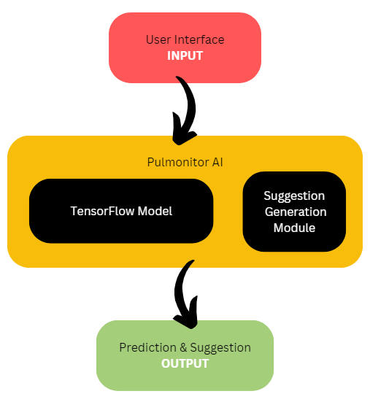
ARCHITECTURE

Slide 9
MODULES USED
USER INTERACTION
Uploading Image and Displaying Result
Performs Binary Classification Xray Scan image into Safe and Risk classes, along with a confidence score
TENSORFLOW CLASSIFIER
This module is responsible for handling the login and registration of current users as well as new users when they join the platform. This shall include authentication of user details like username and password using tokens which shall be used to manage their sessions.
LOGIN/ SIGN UP MODULE
Performs preprocessing functions on the image to enhance image quality and highlight certain features before feeding it to the model
PRE PROCESSING
Generate a recommendation based on the confidence score and result. Display hospital contacts based on geographical location if needed
RECOMMENDATION

Slide 10
MODULES USED
Landing Page
Upload Image
View Result
View Recommendations
About Page
Contact Page
USER INTERACTION
TensorFlow r2.16
Model: Vision Transformer (ViT)
extracts features from images, capturing both local and global dependencies
Embedded with LSTM & SVC
captures sequential patterns and long-range dependencies
Training data (5216 images):
1341 Normal
3875 Pneumonia
Testing data (624 images):
234 Normal
390 Pneumonia
Returns prediction along with Confidence Score
TENSORFLOW
CLASSIFIER

Slide 11
Handling class imbalance with balancing number of images in Normal and Pneumonia classes
Resizing images
Normalizing pixel values
Color space conversion
Histogram Equalization
PRE PROCESSING
Recommend consulting with medical practitioner if confidence score over a threshold value
Recommend hospitals / doctors specializing in this, based on user location
RECOMMENDATION

Slide 12
References
Diagnosis of pneumonia from chest X-ray images using deep learning
https://ieeexplore.ieee.org/abstract/document/8741582/
Detection of pneumonia in chest X-ray images
https://content.iospress.com/articles/journal-of-x-ray-science-and-technology/xst00304
Intelligent pneumonia identification from chest x-rays: A systematic literature review
https://ieeexplore.ieee.org/abstract/document/9389754/
Pneumonia classification using deep learning from chest X-ray images during COVID-19
https://link.springer.com/article/10.1007/s12559-020-09787-5
A novel transfer learning based approach for pneumonia detection in chest X-ray images
https://www.mdpi.com/2076-3417/10/2/559

Slide 13
References
Transfer learning with deep convolutional neural network (CNN) for pneumonia detection using chest X-ray
https://www.mdpi.com/2076-3417/10/9/3233
Deep convolutional neural network with transfer learning for detecting pneumonia on chest X-rays
https://link.springer.com/chapter/10.1007/978-981-15-0339-9_13
Classifying pneumonia among chest X-rays using transfer learning
https://ieeexplore.ieee.org/abstract/document/9175594/
Automated pneumonia detection on chest X-ray images: A deep learning approach with different optimizers and transfer learning architectures
https://www.sciencedirect.com/science/article/pii/S0263224121008885
https://www.spiedigitallibrary.org/conference-proceedings-of-spie/11734/117340E/Diagnosing-COVID-19-pneumonia-from-x-ray-and-CT-images/10.1117/12.2588672.short

